Slide 1


Text Mining - Clustering MK Data Mining 2
Dr. Maryamah, S.Kom
Program Studi S1 Teknologi Sains Data
Fakultas Teknologi Maju dan Multidisiplin
Universitas Airlangga Indonesia
www.ftmm.unair.ac.id
@ftmmunair

Slide 2
Outline
Review Unsupervised Learning & its method
Text as a data
Text Representation / Feature Extraction
Descriptive Text Mining
Term Frequency
Text Clustering
www.ftmm.unair.ac.id
@ftmmunair

Slide 3

What is Unsupervised Learning?

Slide 4
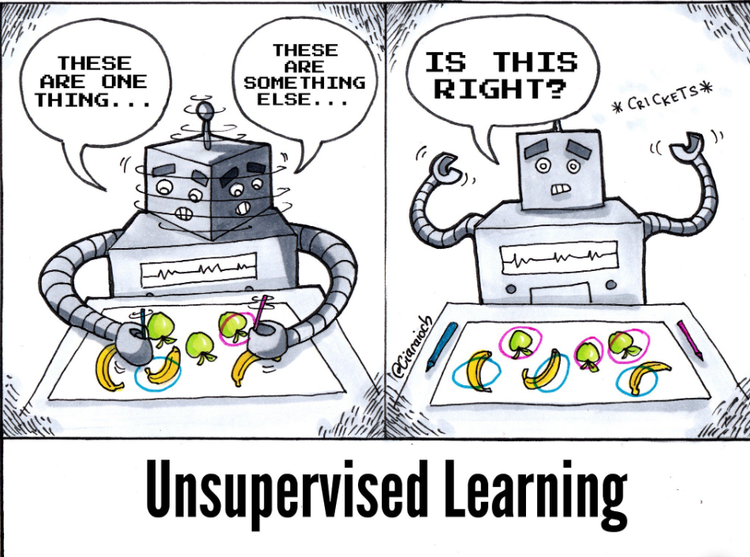
Unsupervised Methods?

Slide 5
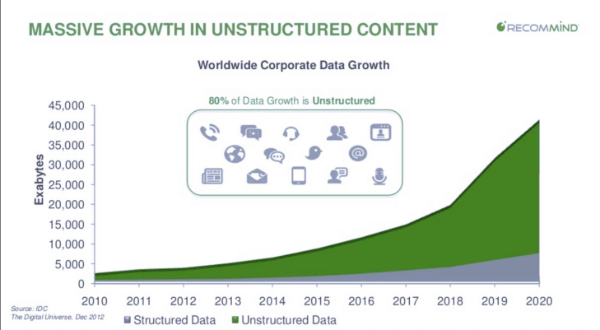
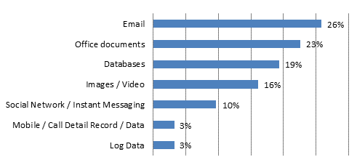

Slide 6


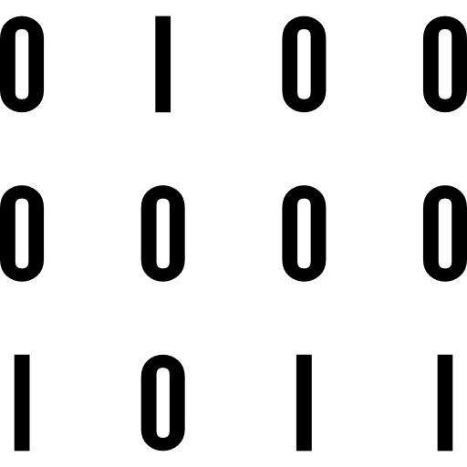

Text as data

Slide 7
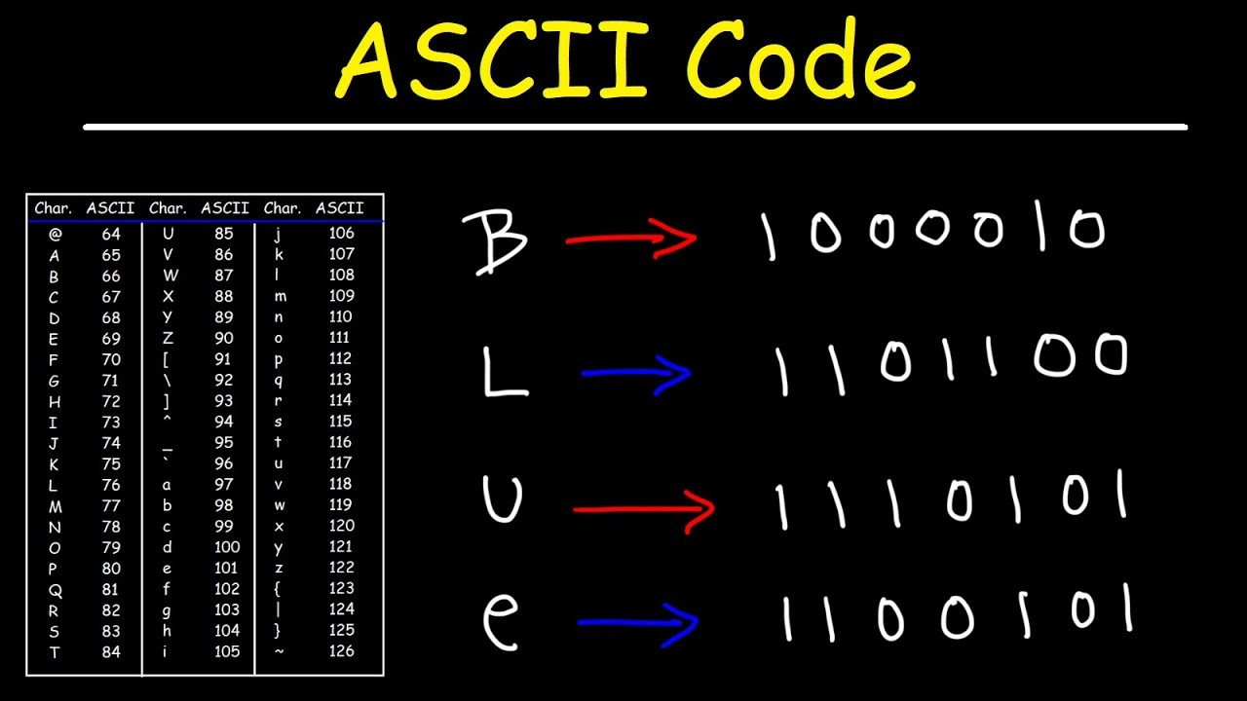
Text as a data
Books and writings has been around for a thousand (or more) years
Every knowledge known to human is usually recorded in writings
These texts become data (because it is from observations)
In computers, text is encoded using numbers (ASCII, Unicode, etc.)
Notes:
But, computers didn’t really understand what it means
To them, it’s only numbers and how to display it according to the encoding codebase
To represent text (and its meaning) we need to do some steps…

Slide 8
Text Preprocessing
Cleaning
Tokenization
Filtering
Stemming / Lemmatizing

Slide 9
Text Cleaning
“Hey Amazon - my package never arrived https://www.amazon.com/gp/css/order-history?ref_=nav_orders_first PLEASE FIX ASAP! @AmazonHelp”
Computers need to clean the text, and separate it into meaningful feature
Remove symbols (irrelevant to meaning)
Remove links
Remove mentions
Normalize text (ASAP)

Slide 10
Text cleaning
Computers encode “Hey” and “hey” differently. Because?
Computers will also process - : , “ + etc. It is not usable for analysis
How to make all letters in lower case?
How to remove symbols / special characters / numbers?

Slide 11
Text Cleaning
To clean text from symbol, Regular Expression can be used
Regular Expression search for patterns, and can be used to remove unwanted patterns (and symbols)
In Python, string method lower() can be used to decapitalized all the letters

Slide 12
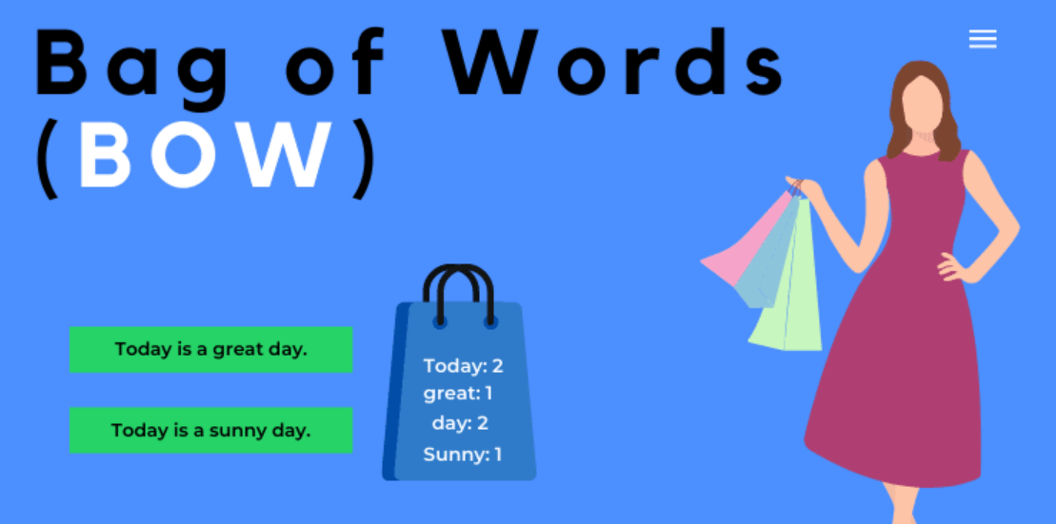
Text Tokenization
Simply means splitting
Paragraphs become list of sentences, Sentences become list of words
Words can be processed further individually
Sometimes named Bag of Words
the bag of words approach to text mining is the most common method for performing computations on string data
the data are broken down into tokens.
A token can be thought of as a unit of a certain or uncertain length, depending on the context in which string data is tokenized.
Tokens can be as small as a single character or as large as an entire text document.

Slide 13
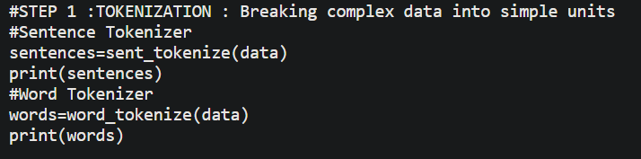
Tokenization with NLTK
Sentence tokenization : split a paragraph into list of sentences using sent_tokenize() method
Word tokenization : split a sentence into list of words using word_tokenize() method
from nltk.tokenize import sent_tokenize, word_tokenize

Slide 14
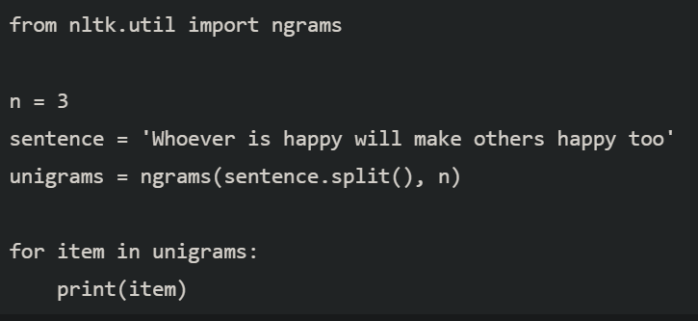
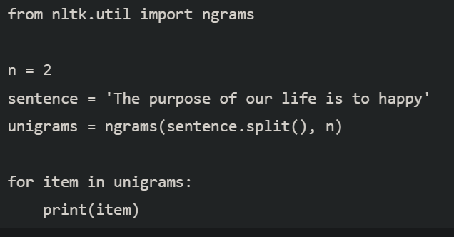
Some important thing in tokenization
Sometimes single word cannot represent meanings
“Kemarin aku beli sepeda pinarello baru”
N-gram
Unigram = [“kemarin”,”aku”,”beli”,”sepeda”,”pinarello”,”baru”]
Bigram = [“kemarin aku”,”aku beli”,”beli sepeda”,”sepeda pinarello”,”pinarello baru”]
Trigram = [“kemarin aku beli”,”beli sepeda pinarello”,”sepeda pinarello baru”]
Notes:
Gunanya?

Slide 15
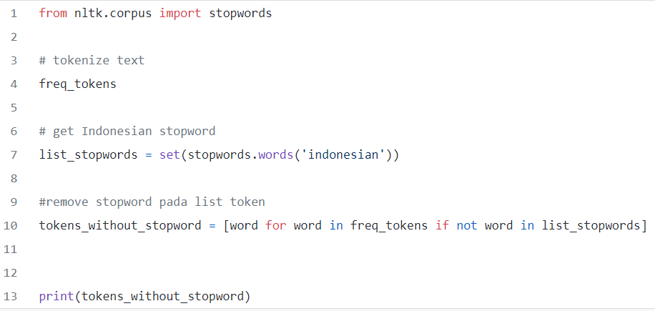
Filtering
Sometimes, we don’t want specific word to appear in our data / analysis
Stop words are basically a set of commonly used words in any language, and usually useless in analysis
E.g. the, and, for, a, an, another, in, under, ada, adanya, adalah, di, ke, dari,

Slide 16
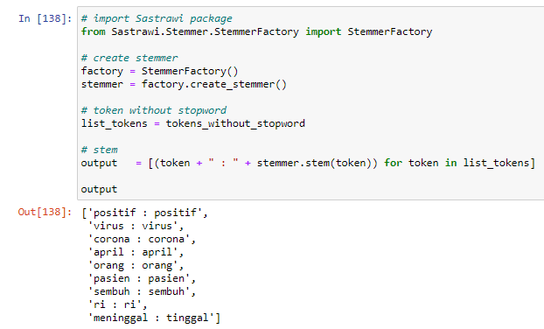
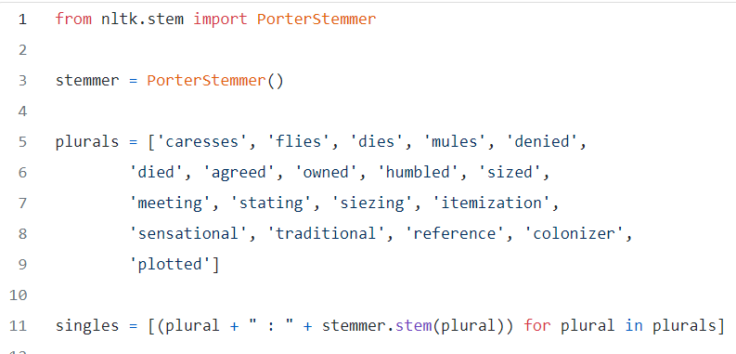
Stemming / Lemmatizing
Returning words to its root form
E.g. Cleaning -> clean, swollen -> swell, menangis -> tangis
Can be very hard, since words can transform

Slide 17

Discussion
Apakah Perlu ?
Stopword
Stemming

Slide 18
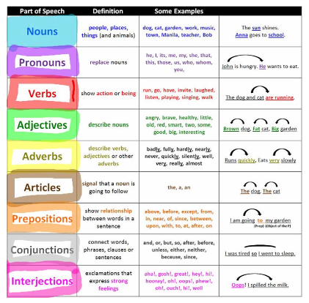
Pos Tagging
POS tagging merupakan proses pemberian tanda berupa kelas kata pada setiap kata yang terdapat di dalam corpus.

Slide 19
Descriptive Text Analysis
After preprocessing the text data, you have a corpus of words (in whatever document you have)
You can start counting the frequency of words (most common words), counting the basic dominant topics (in sentiment analysis), etc
You can also visualize the wordcloud or top 10 used words
Word Cloud can be used in the analysis of words present in the corpus. Suppose you have a 2000–3000 words and we want to analyse which is the most common words or repeated words in the document.

Slide 20
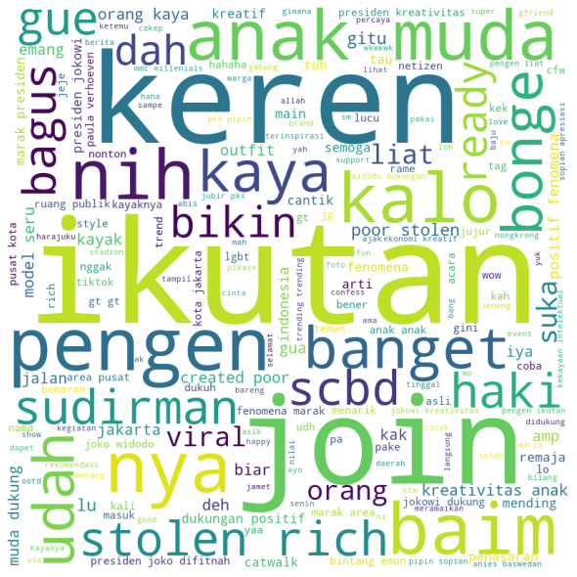
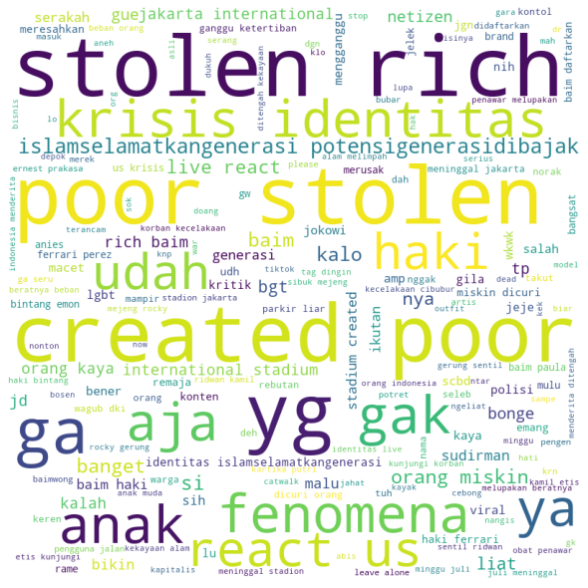
Example: sentiment analysis of citayam
Positive Tweet Documents
Negative Tweet Documents

Slide 21
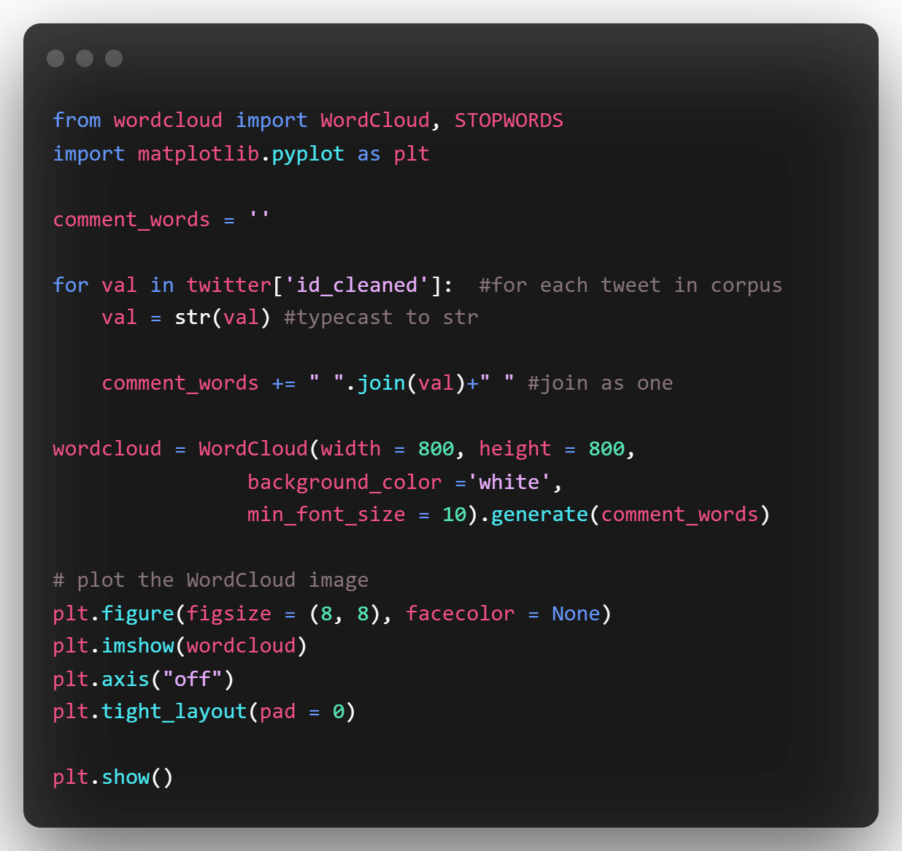
Wordcloud

Slide 22
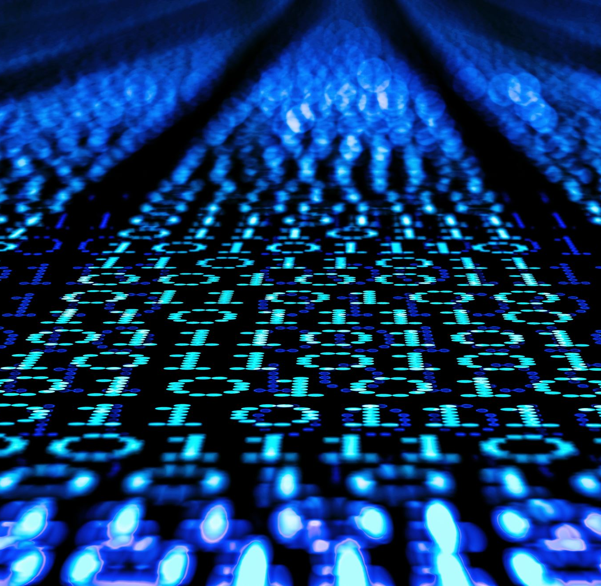
Term Frequency

Slide 23
Term Frequency
Proses penghitungan bobot tiap term yang dicari pada setiap dokumen sehingga dapat diketahui ketersediaan dan kemiripan suatu term di dalam dokumen
Term Frequency:
Bag of Words
Term Weighting

Slide 24
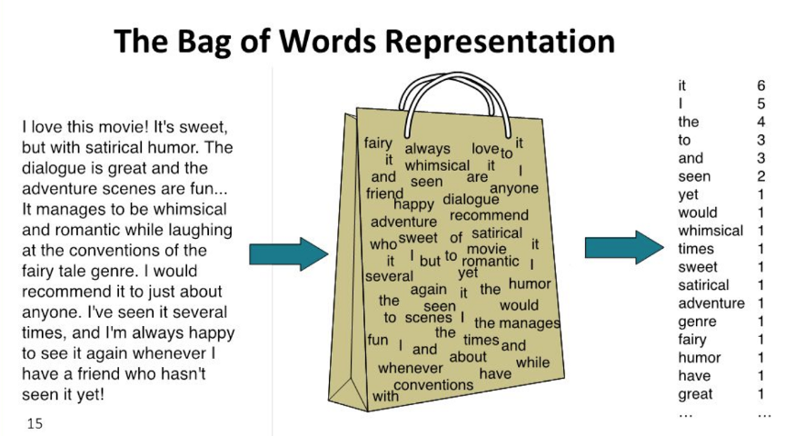

Slide 25

Introduction
Term weighting (pembobotan kata) merupakan proses penghitungan bobot tiap term pada setiap dokumen.
Email (1 halaman)
Buku (1 halaman)
Text pidato (1 paragraf)
Dokumen?
d1
Ukuran nasi sangatlah kecil, namun saya selalu makan nasi
d2
Nasi berasal dari beras yang ditanam di sawah. Sawah berukuran kecil hanya bisa ditanami sedikit beras

Slide 26


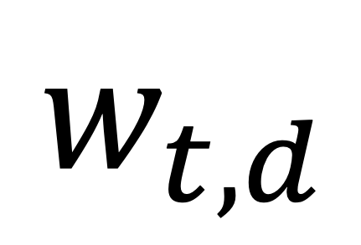
Introduction
Setelah melalui Preprocessing (lower case, stopword, stemming):
d1
ukur, nasi, makan
d2
nasi, beras, tanam, sawah
Tujuan term weighting: mengetahui ketersediaan dan kemiripan term di dalam dokumen.
$$w_{t,d}$$
Term

Slide 27
Metode Term Weighting
Binary term weighting
Term Frequency (TF)
Inverse Document Frequency (IDF)
TF-IDF

Slide 28
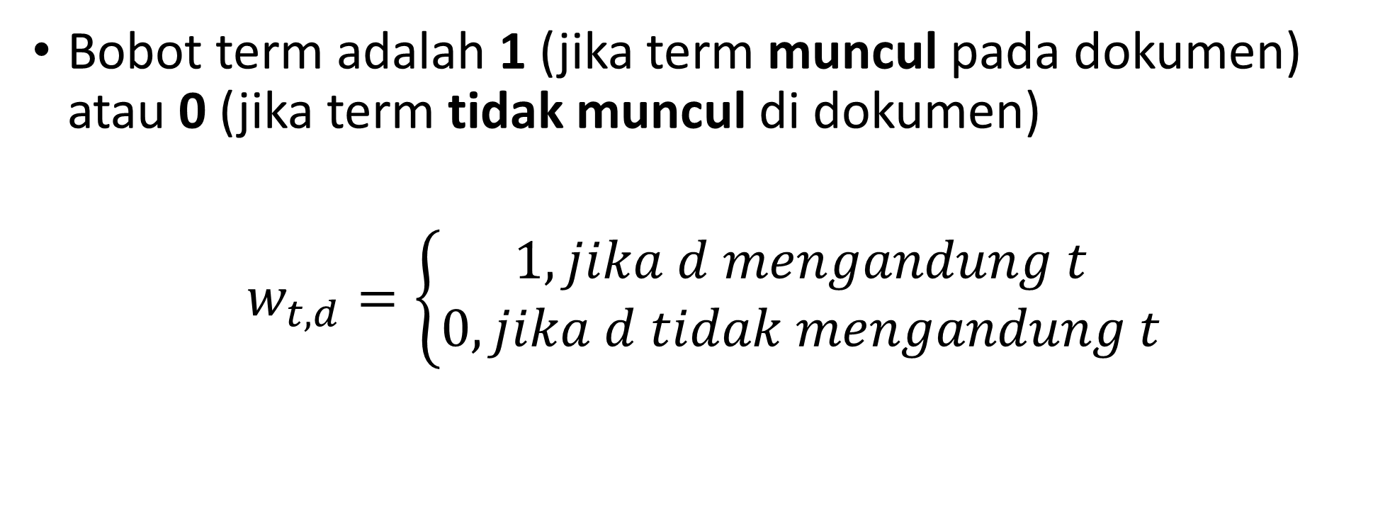
Binary Term Weighting
Bobot term adalah 1 (jika term muncul pada dokumen) atau 0 (jika term tidak muncul di dokumen)
$$w_{t,d}=\left\{\begin{aligned}1, jika d mengandung t \\ 0, jika d tidak mengandung t\end{aligned}\right.$$

Slide 29
Binary Term Weighting
Contoh
d1 : Kucing makan ikan
d2 : Manusia makan nasi dan makan ikan
Kelebihan :
Mudah diimplementasikan
Kekurangan :
Tidak dapat membedakan term yang sering muncul ataupun term yang hanya sekali muncul
Kata | d1 | d2
Kucing | 1 | 0
Makan | 1 | 1
Ikan | 1 | 1
Manusia | 0 | 1
Nasi | 0 | 1
29

Slide 30
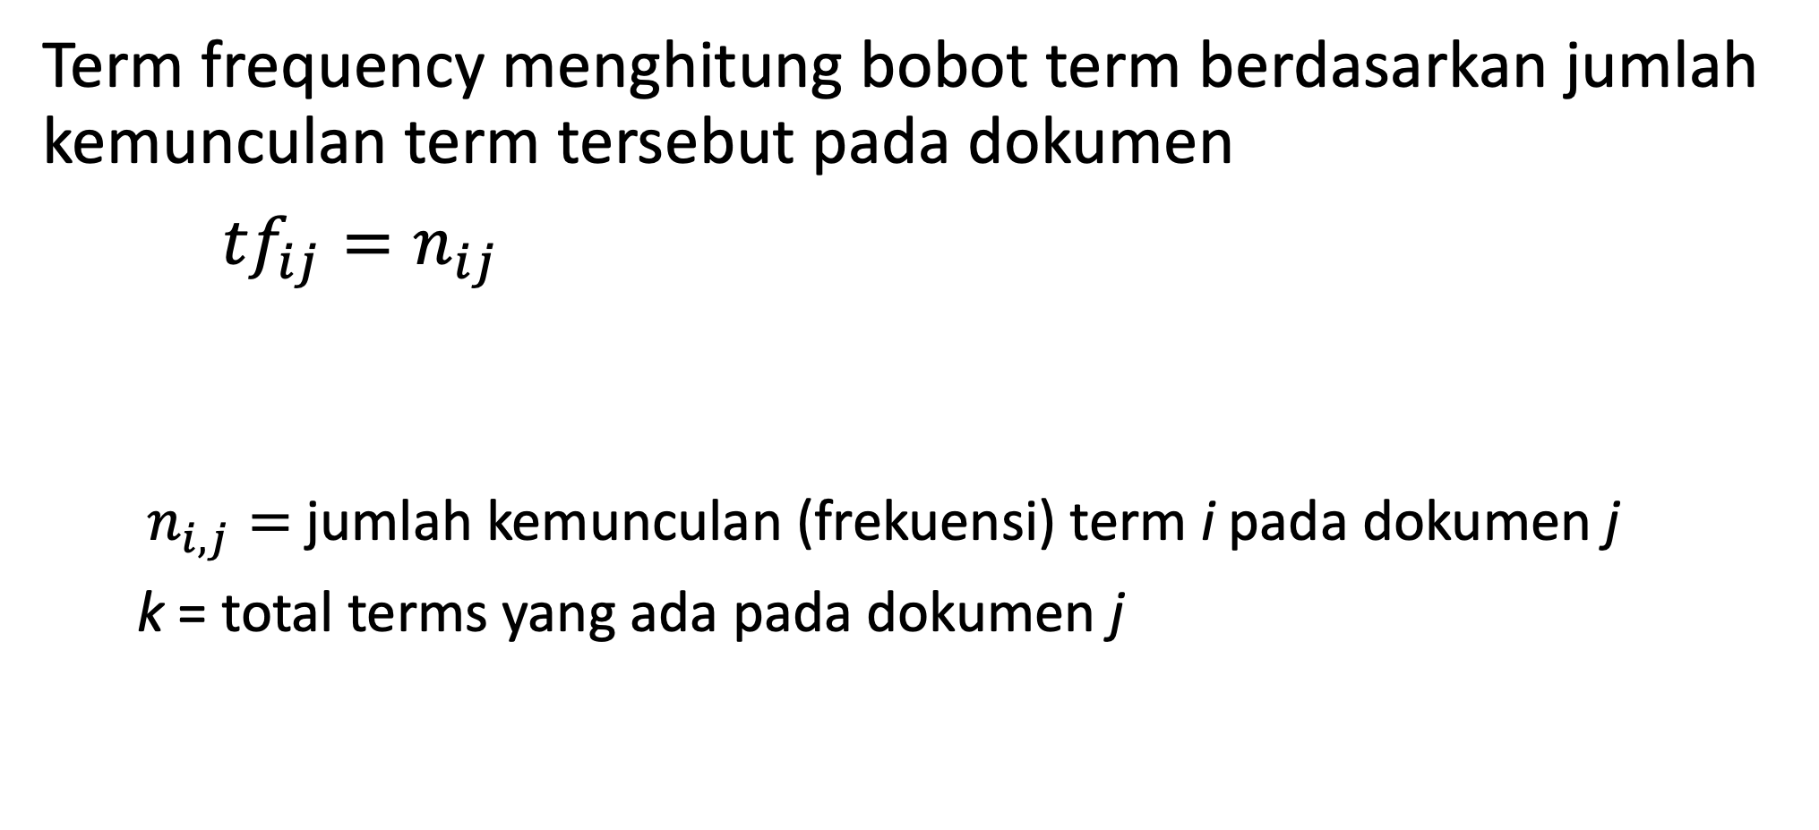
Term Frequency (TF)
Term frequency menghitung bobot term berdasarkan jumlah kemunculan term tersebut pada dokumen
${tf}_{ij}=n_{ij}$
$n_{i,j}=$jumlah kemunculan (frekuensi) term i pada dokumen j
k = total terms yang ada pada dokumen j

Slide 31
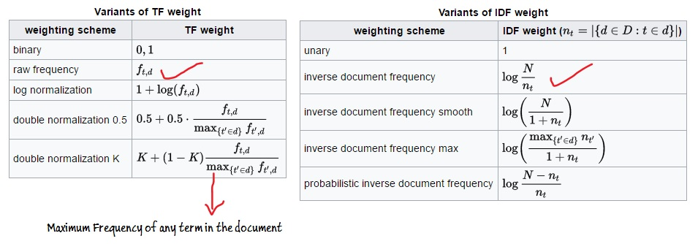
Term Frequency (TF)

Slide 32
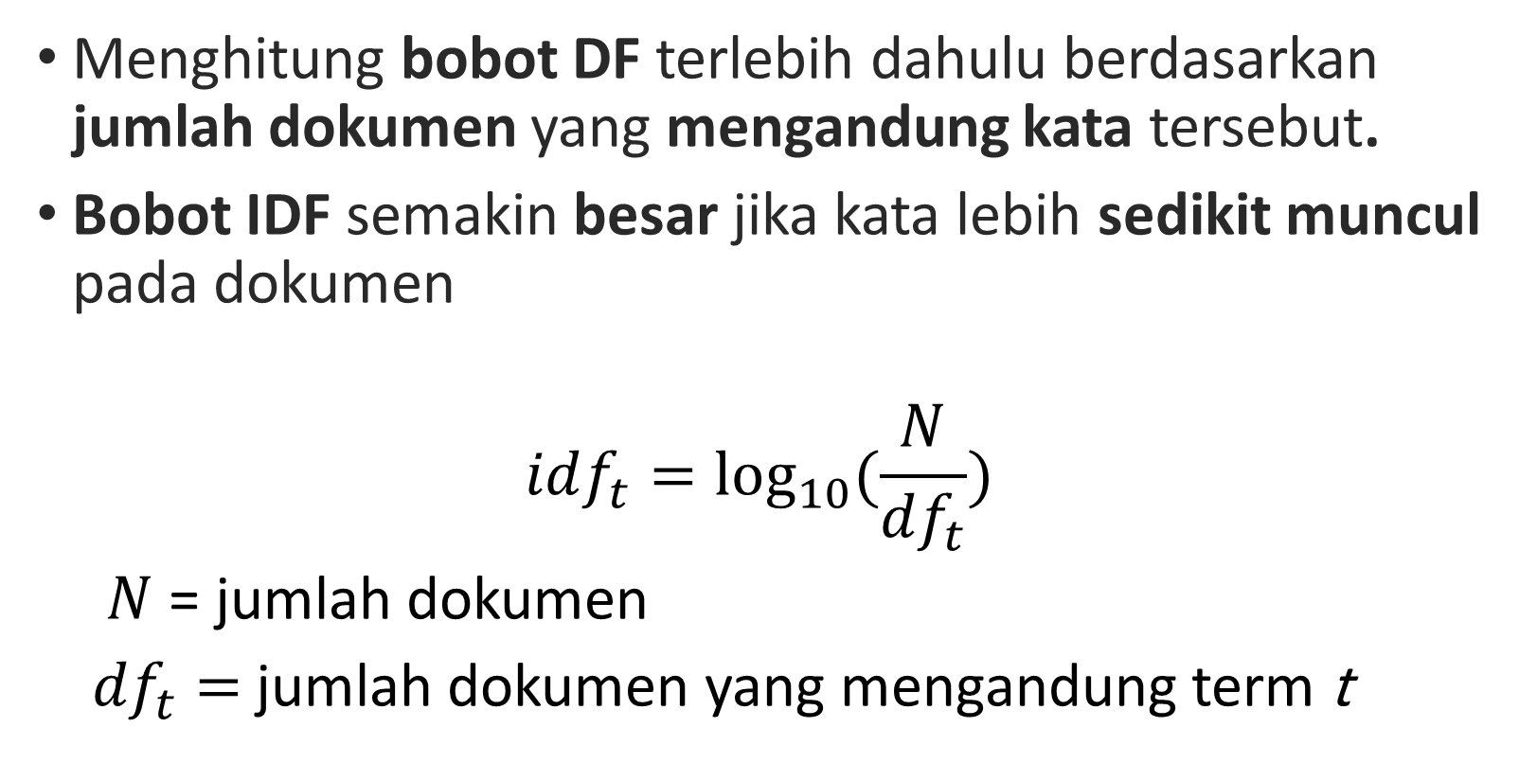
Inverse Document Frequency (IDF)
Menghitung bobot DF terlebih dahulu berdasarkan jumlah dokumen yang mengandung kata tersebut.
Bobot IDF semakin besar jika kata lebih sedikit muncul pada dokumen
$$idf_{t}=\log_{10}{(\frac{N}{df_{t}})}$$
$N$ = jumlah dokumen
${df}_{t}=$jumlah dokumen yang mengandung term t

Slide 33
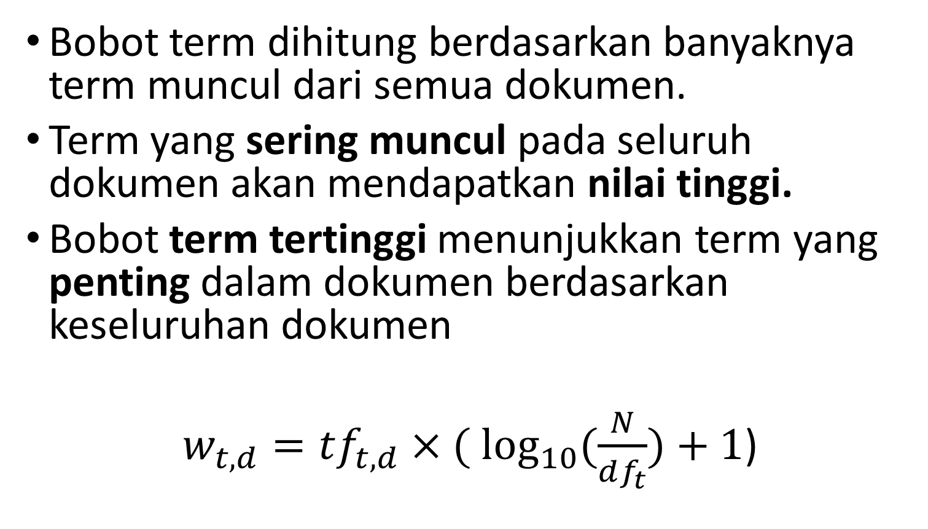
TF-IDF
Bobot term dihitung berdasarkan banyaknya term muncul dari semua dokumen.
Term yang sering muncul pada seluruh dokumen akan mendapatkan nilai tinggi.
Bobot term tertinggi menunjukkan term yang penting dalam dokumen berdasarkan keseluruhan dokumen
$w_{t,d}=tf_{t,d}×(\log_{10}{(\frac{N}{df_{t}})}+1$)

Slide 34
TF-IDF
Contoh
d1 : Kucing makan ikan
d2 : Manusia makan nasi dan makan ikan
Kata | TF |  | DF | IDF | TF-IDF
 | d1 | d2 |  | IDF | d1 | d2
Kucing | 1 | 0 | 1 | 0,3 | 1,3 | 0
Makan | 1 | 2 | 2 | 0 | 1,0 | 2,0
Ikan | 1 | 1 | 2 | 0 | 1,0 | 1,0
Manusia | 0 | 1 | 1 | 0,3 | 0 | 1,3
Nasi | 0 | 1 | 1 | 0,3 | 0 | 1,3
34

Slide 35
TF-IDF
Kelebihan :
Mempertimbangkan frekuensi kata yang dibandingkan dengan seluruh kata pada seluruh dokumen
Kekurangan :
Tidak memperhatikan makna kata.
Word embedding
35

Slide 36
Text Clustering

Slide 37
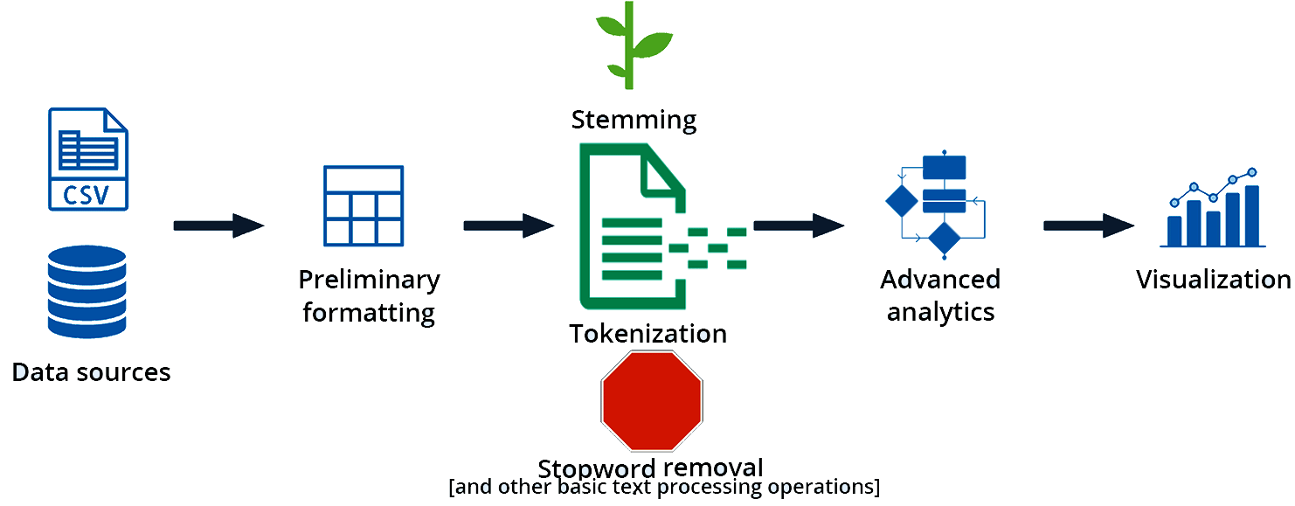

Slide 38
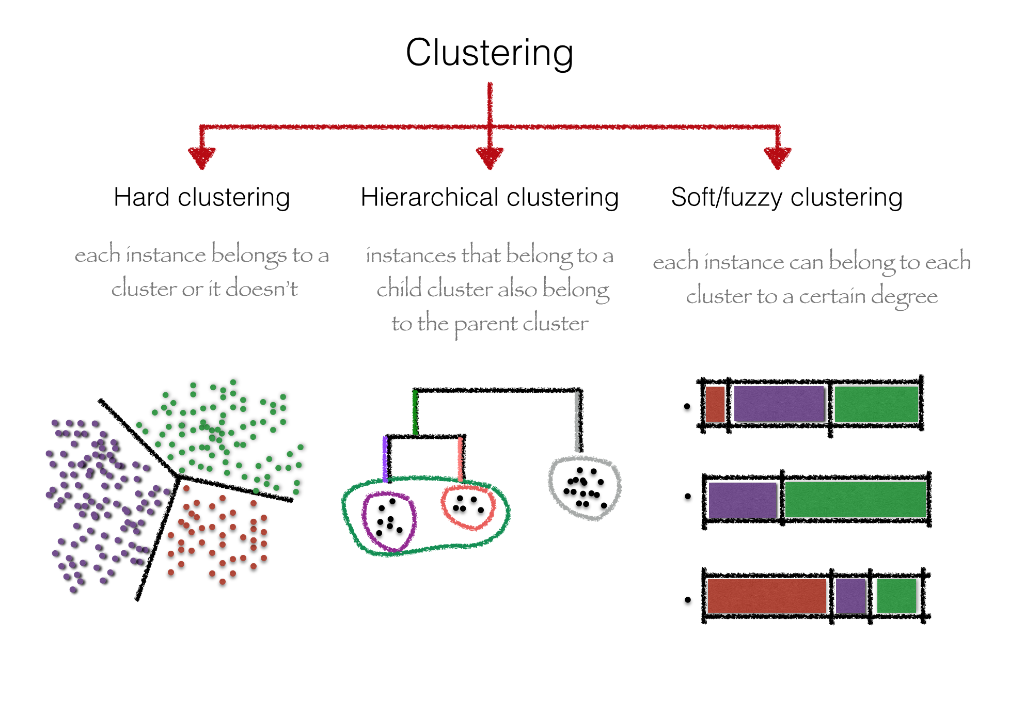

Slide 39
Kmeans Clustering
With vectors of text, any string can be represented with numbers
If plotted into imaginary space, similar vectors will lay closely
We can utilize Kmeans to cluster it based on this!
How to do Kmeans? Anyone?

Slide 40
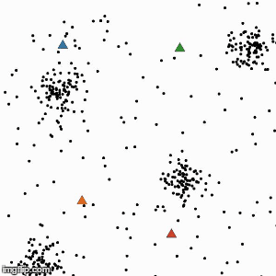
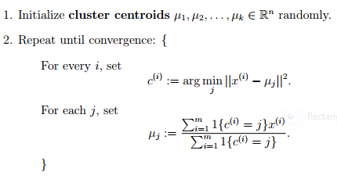
Kmeans

Slide 41
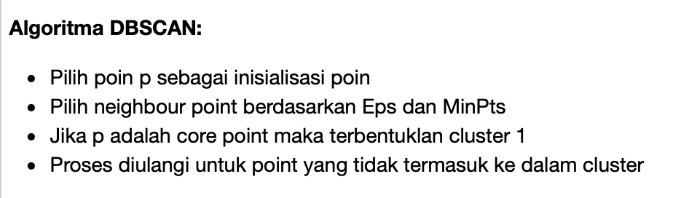
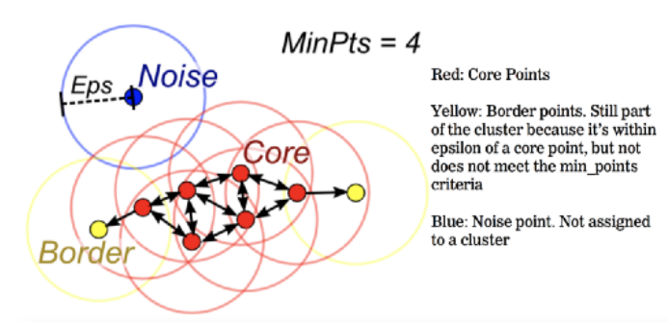
DBScan (Density-Based Spatial Clustering of Applications with Noise)
https://www.analyticsvidhya.com/blog/2020/09/how-dbscan-clustering-works/#:~:text=DBSCAN%20(Density%2DBased%20Spatial%20Clustering,and%20classifying%20outliers%20as%20noise.

Slide 42
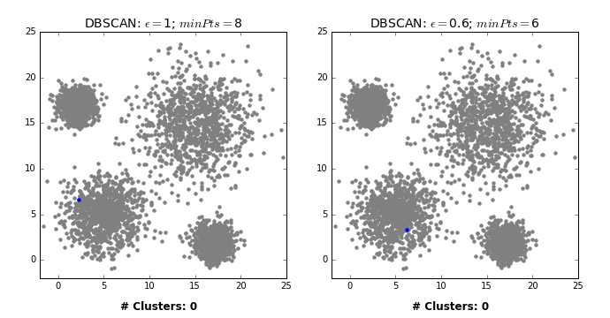
DBScan

Slide 43
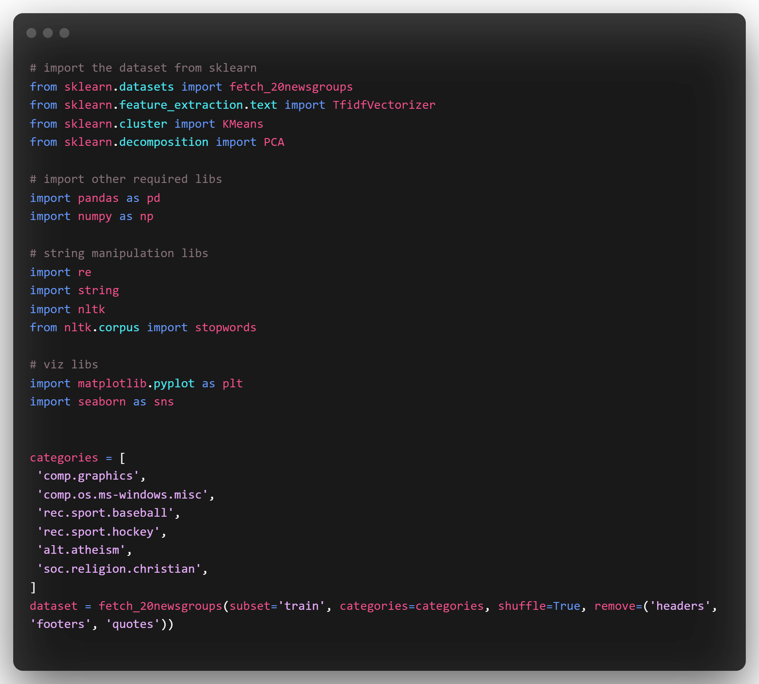
Using sample dataset

Slide 44
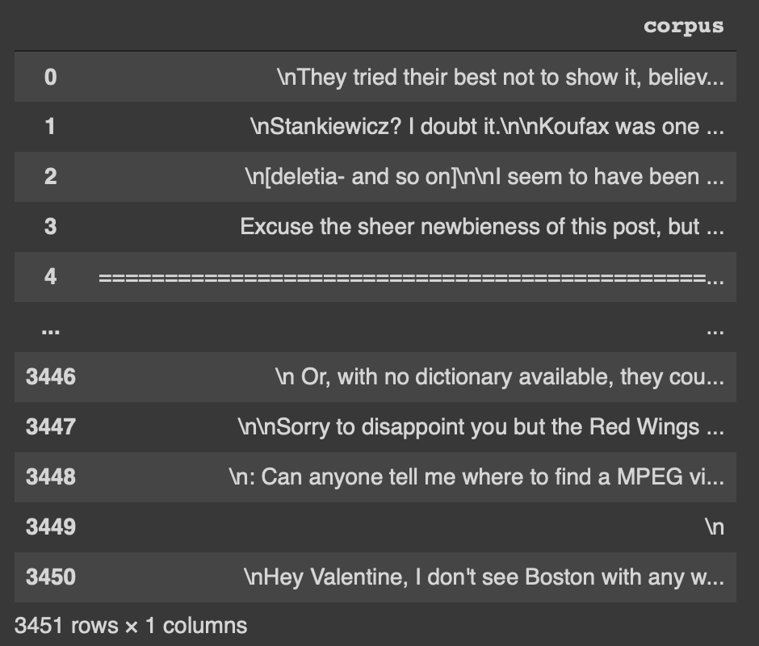

Slide 45
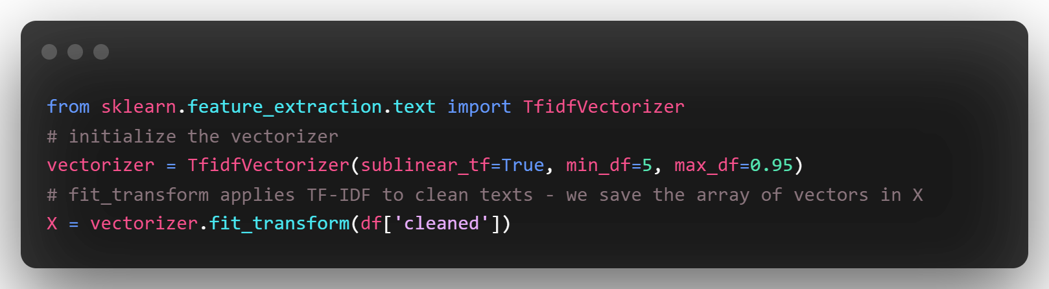

Slide 46
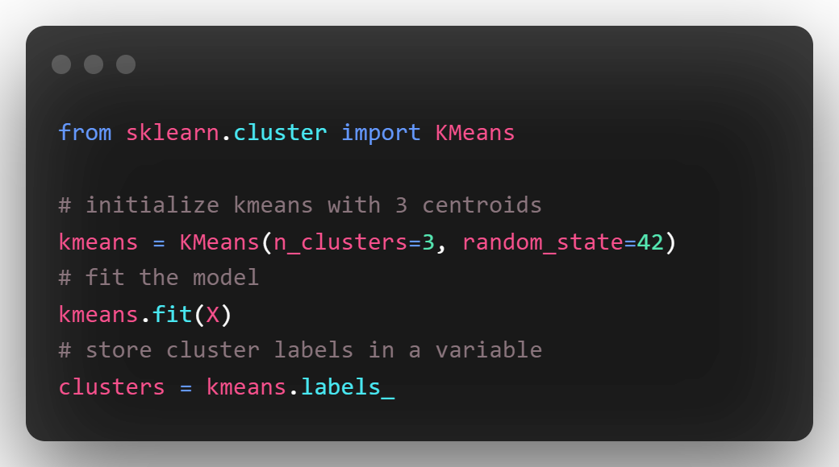

Slide 47
Visualising Cluster
If we look at the dimensionality of X with X.shape we see that it is (3451, 7390).
There are 3451 vectors (one for each text), each with 7390 dimensions. It is definitely impossible to visualize them.
But, we can use PCA (Principal Component Analysis) to reduce (or flatten) the dimension into 2

Slide 48
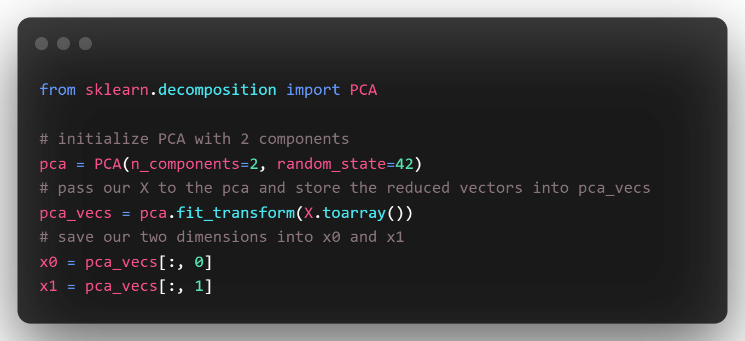
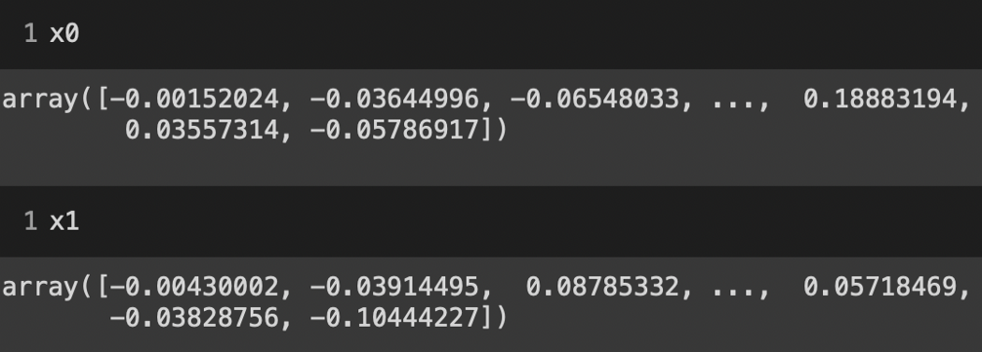

Slide 49
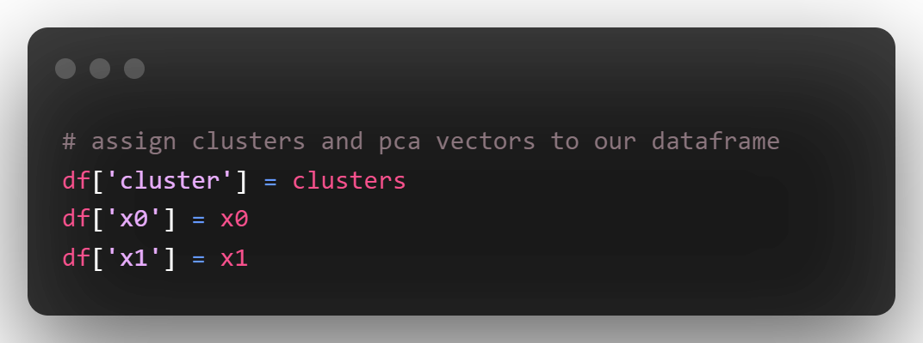
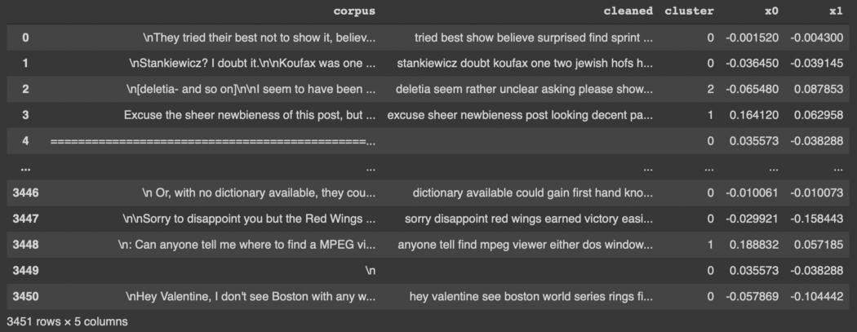

Slide 50
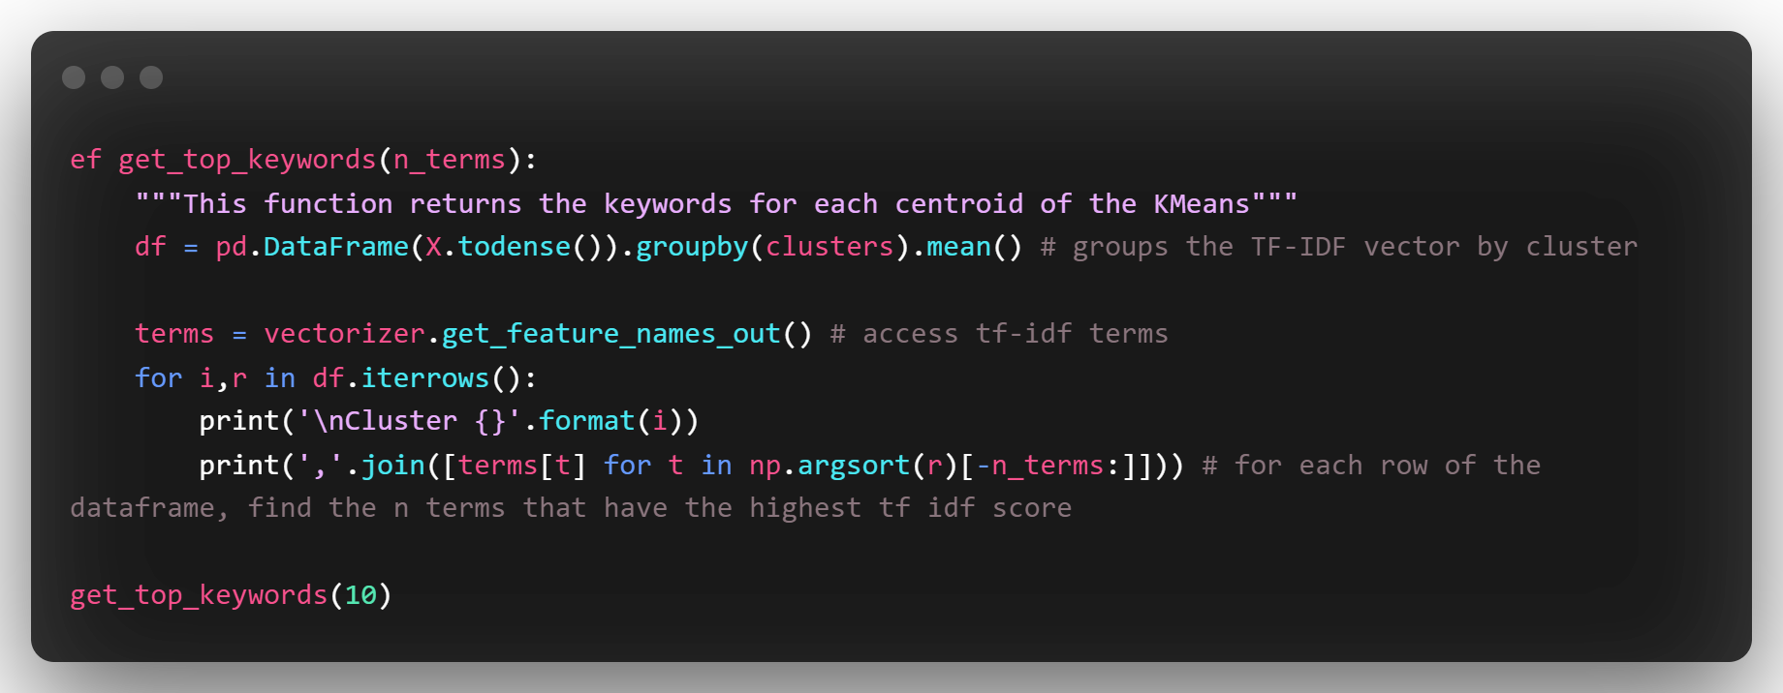
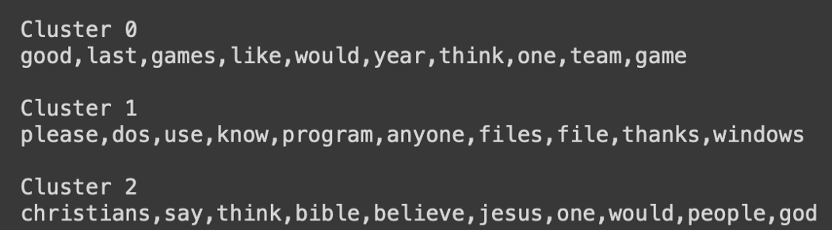
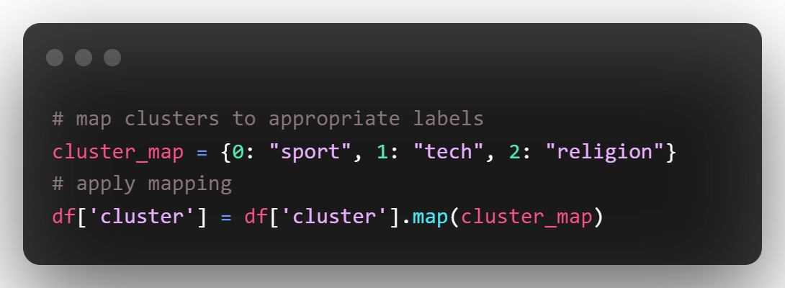

Slide 51
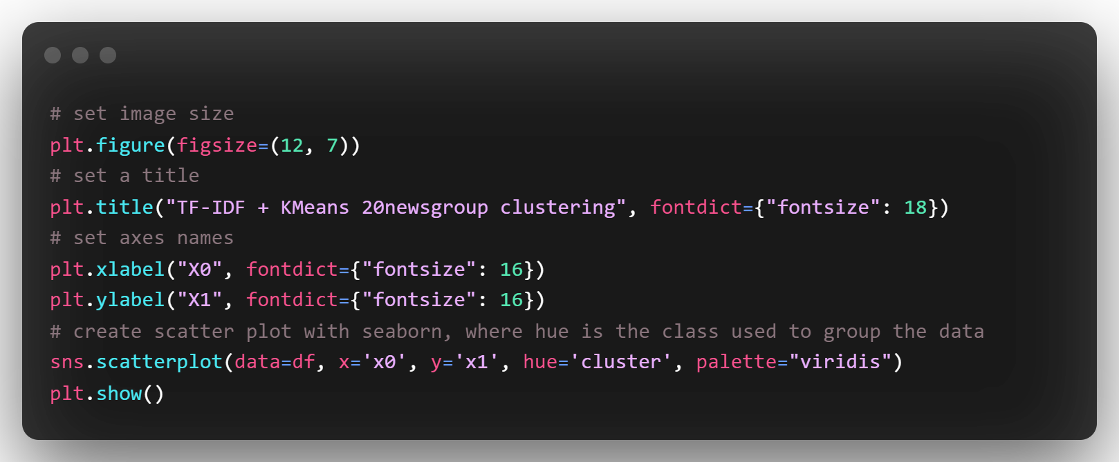

Slide 52
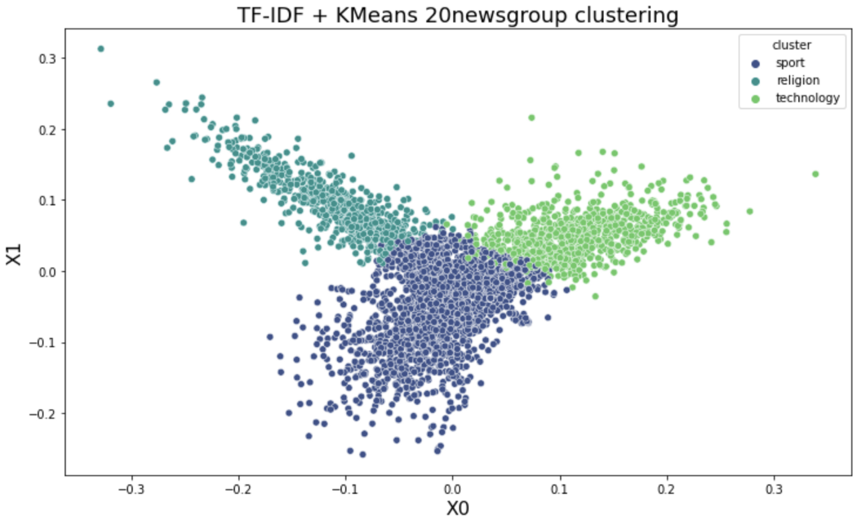

Slide 53
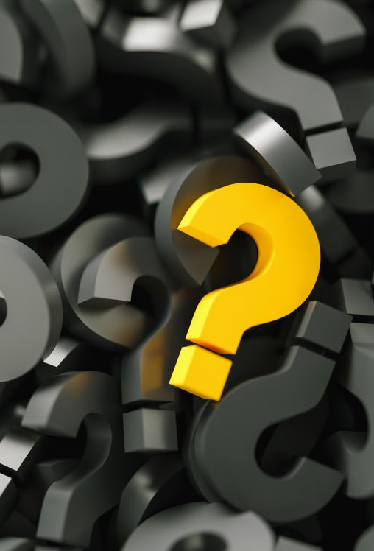
Any Questions?

